Slide 1
International Statistical Institute
&
International Year of Statistics
MyStats 2013
Kuala Lumpur
Vijay Nair
vnn@umich.edu

Slide 2

International Statistical Institute www.isi-web.org
Founded in 1885
Directorate based in The Hague, Netherlands
Mission:
Promote the understanding, development and good practice of statistics worldwide
Covers the entire spectrum of statistical sciences:
academics and research
official statistics
survey statistics
business and industrial statistics
statistical education

Slide 3

ISI Family of Members (2013)
Truly international with members from well over 100 countries
EUROPE : 2453
N. AMERICA : 1417
ASIA : 930
C.&S. AMERICAS : 305
AFRICA : 349
OCEANIA : 272

Slide 4
International Statistical Institute www.isi-web.org
Elected members ~ 2,000
National Statistical Offices, Central Banks, Universities, National Statistical Societies, …
Umbrella for seven international societies
Special Interests Groups
  Life Sciences, Risk Analysis, History, Sports, …
Outreach Committees and Regional Networks
Biennial World Statistics Congress
Focused conferences and workshops
Journals covering different sub-fields
Platform for networking within the international statistical community

Slide 5
International Statistical Institute www.isi-web.org
Statistical Capacity Building in Developing Regions
  Official statistics
  Workshops, short courses, online and onsite
  Mentoring
  Career development for women and young statisticians
Promoting professional ethics for statistical practice, data collection, and dissemination
ISI Regional Networks → ISI – SEAN

Slide 6
2013: International Year of Statistics
Goals:
Increase public awareness of the power and impact of statistics on all aspects of society
Nurture statistics as a profession, especially among young people
Promote creativity and development in the sciences of probability and statistics
Initiated by a group of seven major statistical societies and led by a steering committee

Slide 7
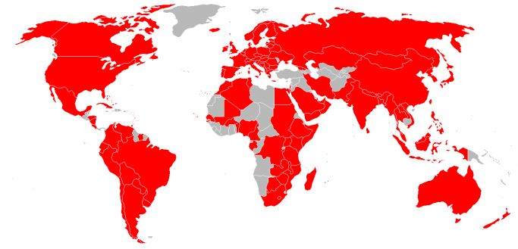
Participating Organizations
About 2,300 organizations, from over 100 countries …
Professional statistical societies, colleges and universities, primary and secondary schools, businesses,
government entities, and research institutes

Slide 8
Why 2013?
300th anniversary of Ars Conjectandi by Jacob Bernoulli
250th anniversary of the publication of Bayes Theorem
Huge number of activities around the world to celebrate and promote statistics
See http://www.statistics2013.org/
Plans to continue the momentum
Thank you Malaysia for your role in making
Statistics 2013 a grand success!

Slide 9
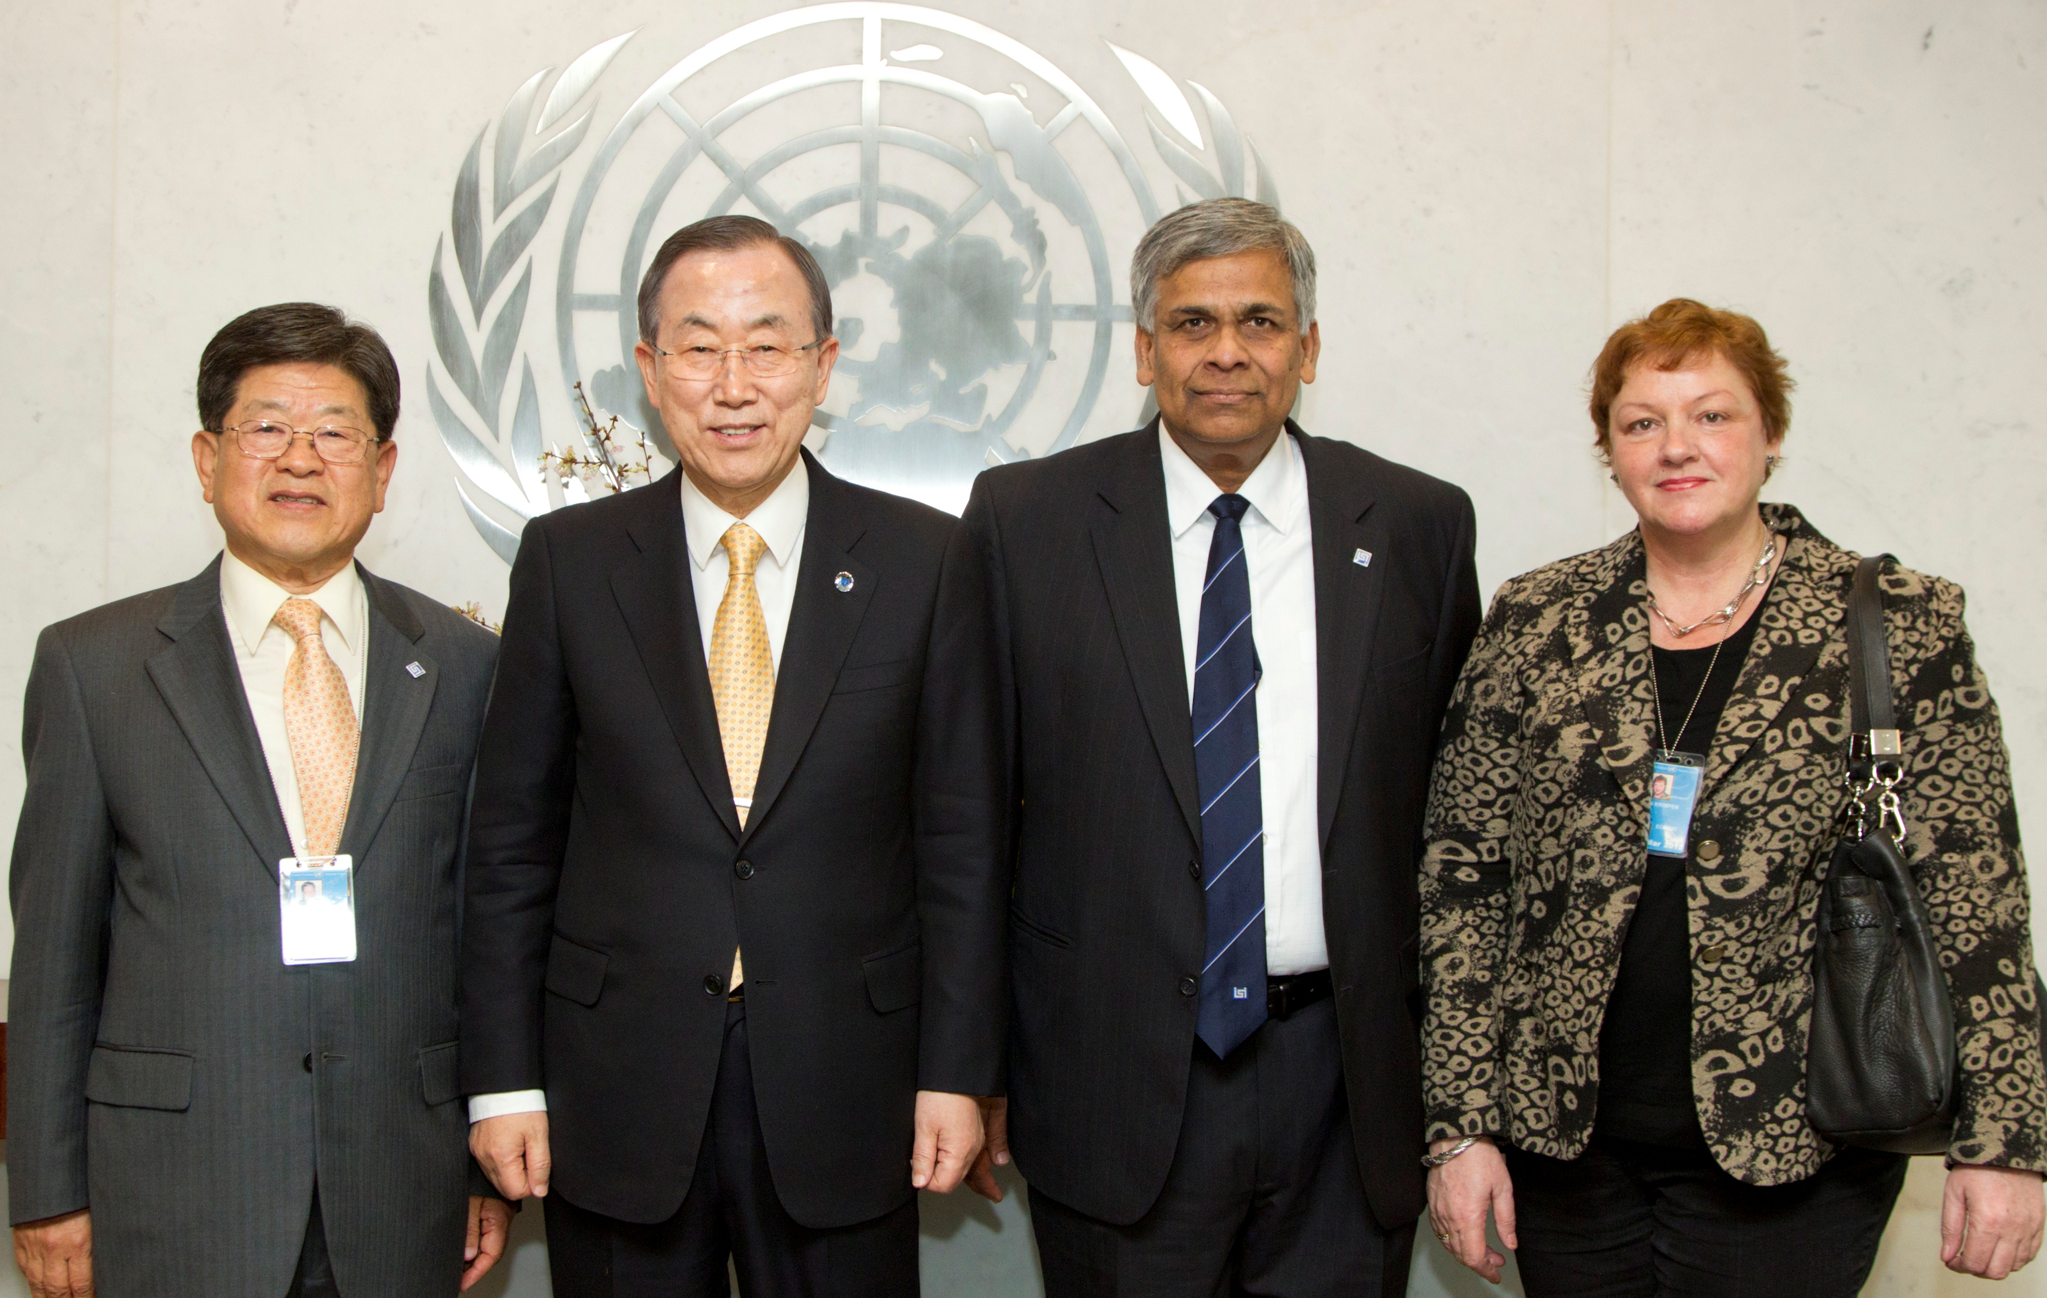
Statistics 2013: Meeting with UN-SG

